Slide 1

Neighborhood Analysis Of England By Vindhya R

Slide 2

Introduction
The housing market in the UK has always been a topic of national attention, with news sites dedicating sections that report on key news that can potentially affect housing prices and the trends in recent months.
For many people, buying a property is one of the most important decision and purchase in life. Besides the affordability of a house, other factors such as the desirability of the location and the long-term investment prospects also affect the decision-making process.
England homebuyers who want to find out more about housing trends in various districts would therefore have little recourse.
In the last decade, the housing market in England has been rapidly growing, with average housing prices increasing by more than 10% yearly on most years .

Slide 3
Business Problem
My client, a resident in UK is looking to settle in England and wants to buy a property. They want a green area, that has good schools, easy access to hospitals and is children friendly.
Since the England demography is so big, my client needs deeper insight from available data in other to decide where to buy a property. My client is asking a help from us to analyse demography of England and give some insight about the Neighbourhoods.

Slide 4
Target Audience
Considering the diversity of UK, there is a high multicultural sense. England is a place where different shades live. As such, in the search for an property, there is a high demand. The target audience is broad, it ranges from people of England, and others who wants to settle in England.

Slide 5
Data
Description of Data
This project will rely on public data from UK government dataset and Foursquare.
Dataset:
Within the England Area, there are lot of Boroughs. The focus of this project will be the neighbourhoods. The England Area consists of 380 Boroughs.
We extract venues from all neighbourhoods within a certain radius and pick top 5 venues in each neighbourhood and analyse which neighbourhoods are good for property investment depending on client’s requirements.

Slide 6
Data (contd)
Cleaning data
Convert the data that are downloaded into a data frame.
Remove the unwanted attributes/columns that are not used in analysis
Rename few columns to give some meaningful names depending on the context
Check the data frame for missing values

Slide 7
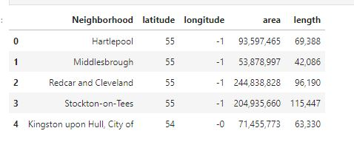
Data (contd)

Slide 8
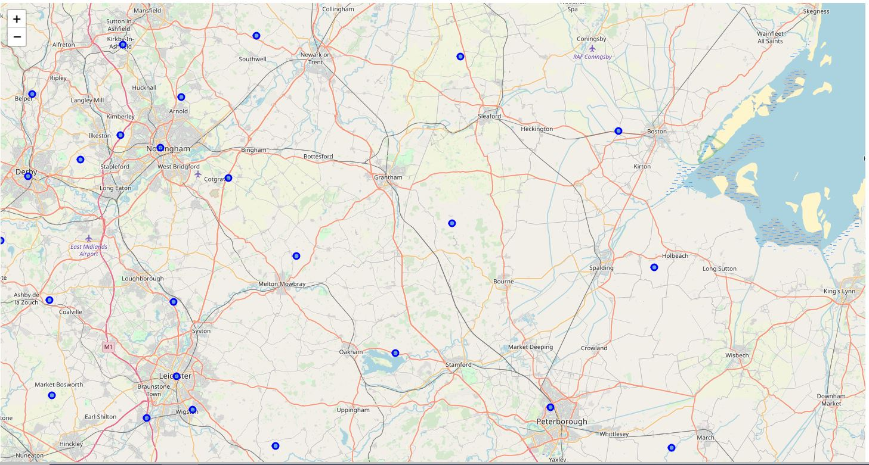
Methodology
As said before my client wants to buy a property and settle in England. I have analysed the neighbourhood of England. First, have extracted the latitude and longitude of England. The map of England is shown here

Slide 9
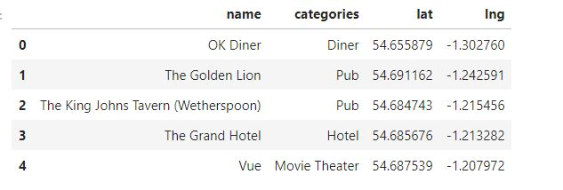
Methodology (contd)
Extract the first neighborhood from the data frame i.e. Haretlpool and using foursquare API fetch nearby venues in Hartelpool within a specified radius.

Slide 10
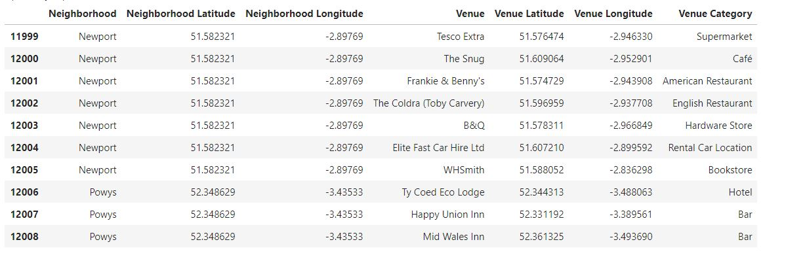
Methodology (contd)
We get the nearby venues from all neigbourhoods in the dataframe and put them in a dataframe along with the category of that venue

Slide 11
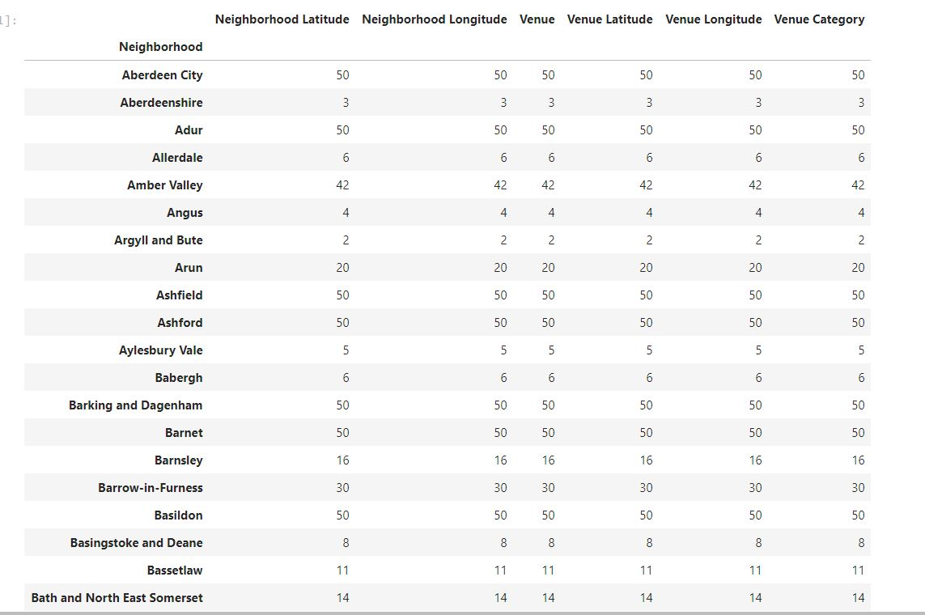
Methodology(contd)
The venues are counted for each neighborhood for ease of analysis

Slide 12
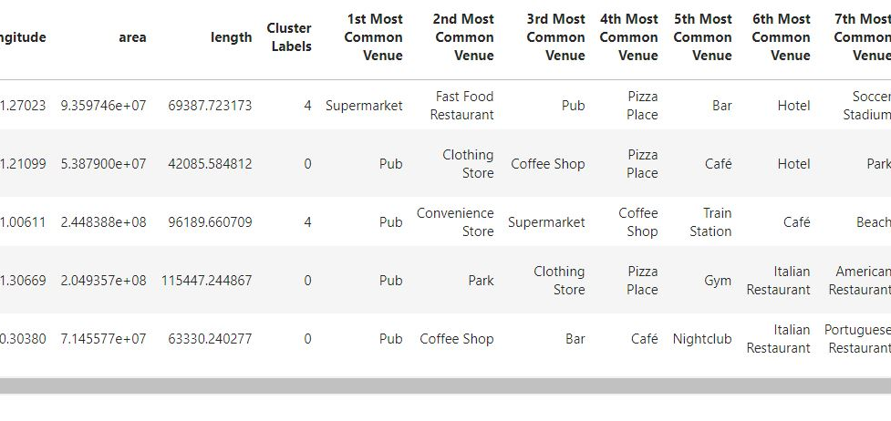
Modelling
We have used K-means clustering here because it is fast and efficient in terms of computational cost, is highly flexible to account for mutations in real estate market in England and is accurate.
The resulting dataframe after clustering and merging is shown below

Slide 13
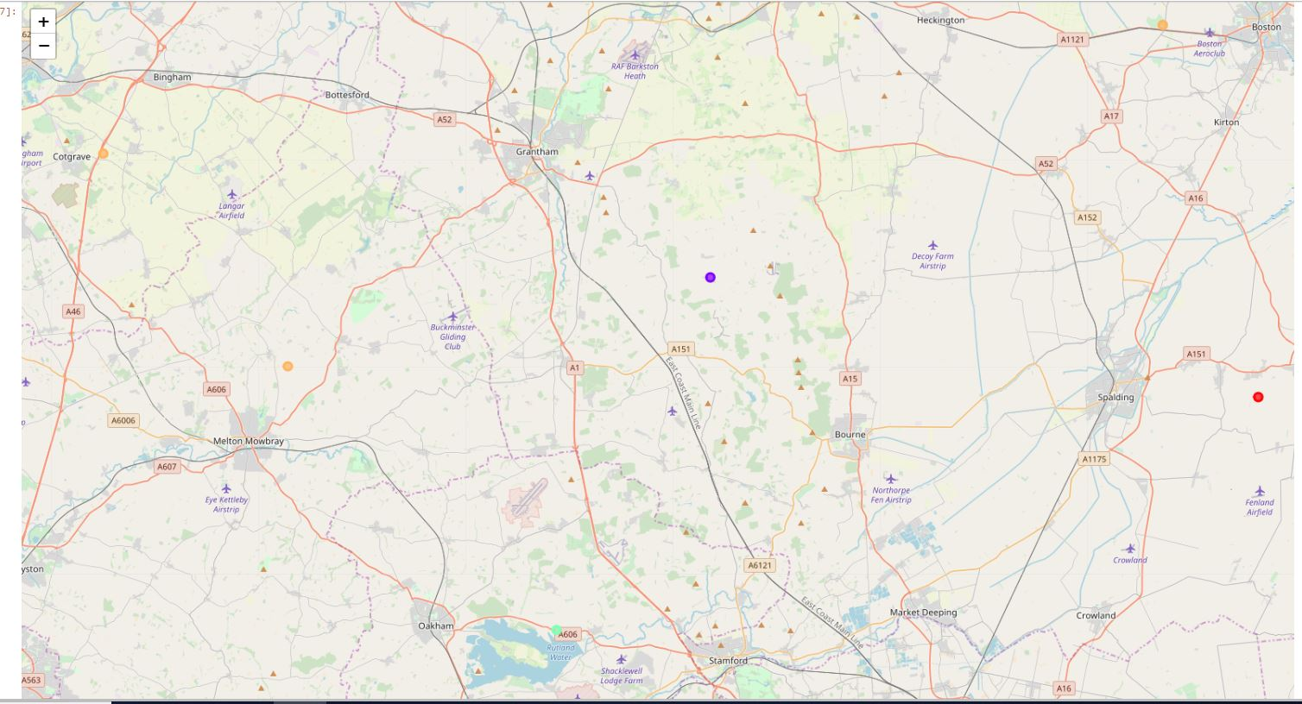
Modelling (contd)
The map is shown after clustering

Slide 14
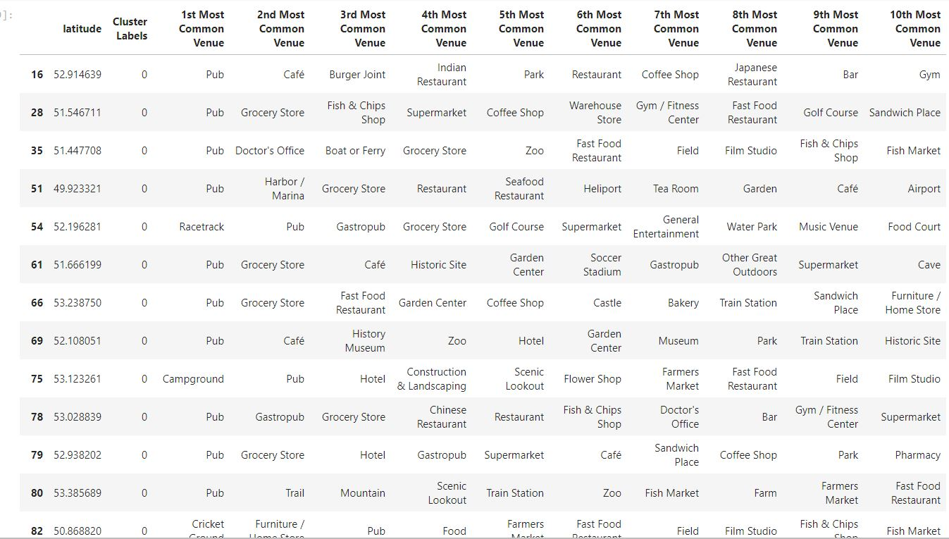
Result
The neighbourhood clustering results as 5 different clusters
First Cluster
Analysis: As we can see here in first cluster there are lot of pubs, coffee shops, restaurants and cafes. This may not be ideal for a family with children like my client. This is good for people who hang out often and enjoy partying.

Slide 15
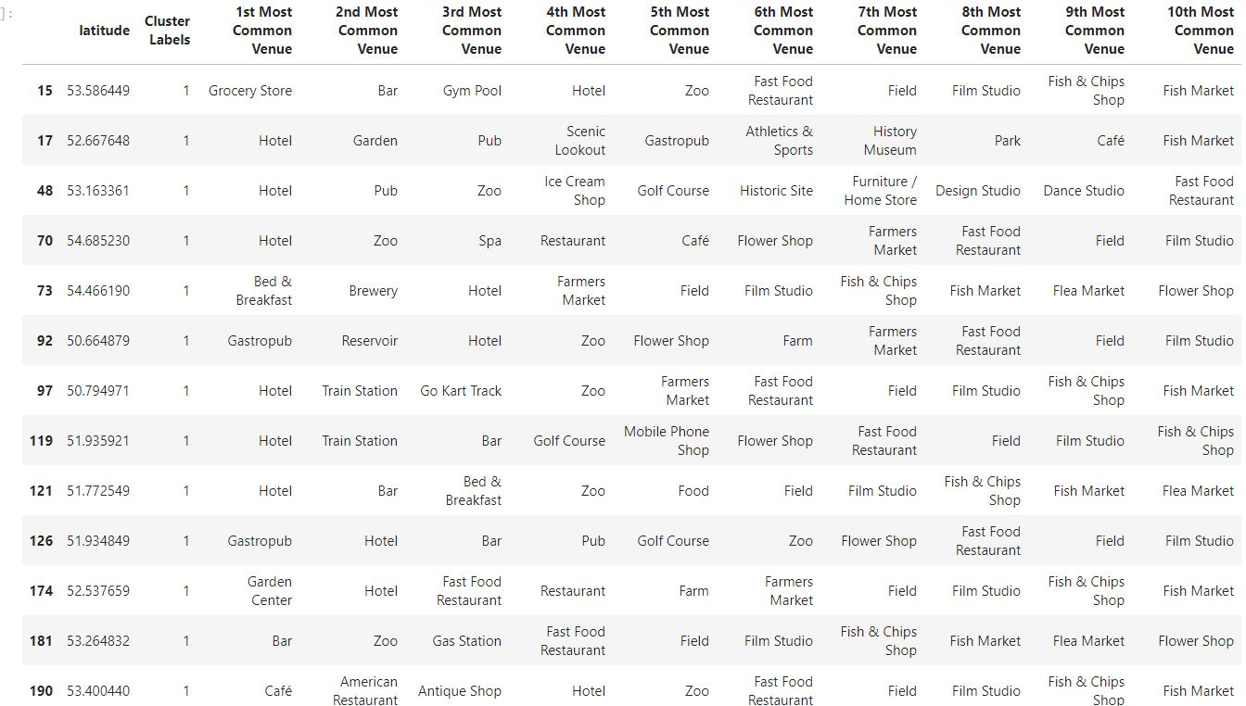
Result (contd)
Second Cluster
Analysis: Here there are pubs and café but compared to first cluster we see gardens, grocery stores, park, pharmacy, Zoo, bookstores. This is ideal for a family.

Slide 16
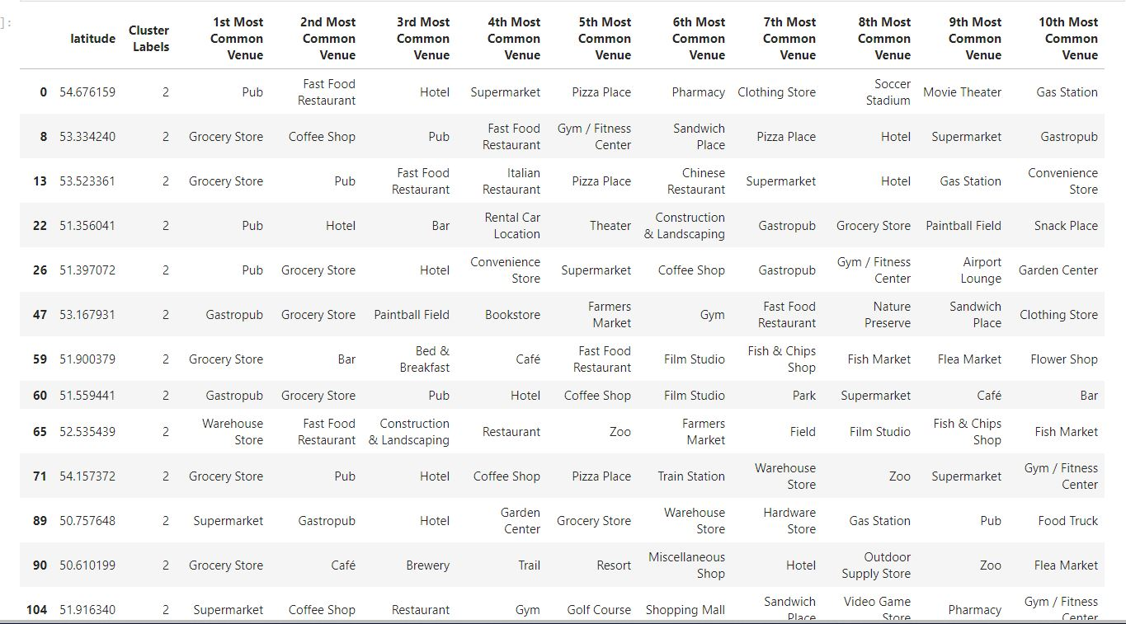
Result (contd)
Third Cluster
Analysis: There are lot of markets, Historic places, Train station, park so this is a good choice for a family with children.

Slide 17
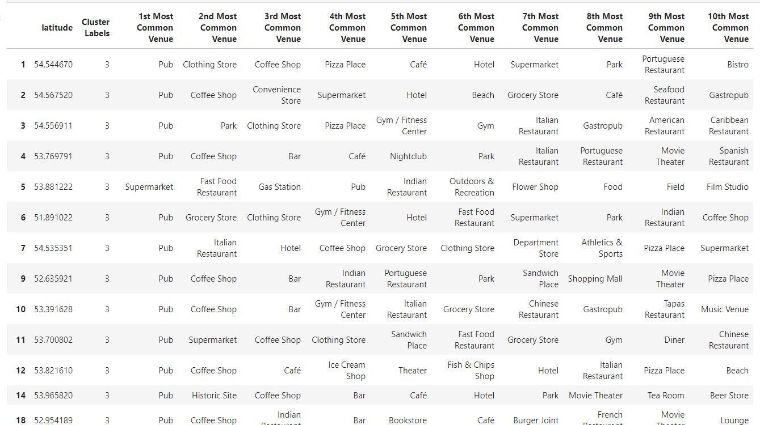
Result (contd)
Fourth Cluster
Analysis: As we can see here in first cluster there are lot of pubs, coffee shops, restaurants and cafes. This may not be ideal for a family with children like my client. This is good for people who hang out often and enjoy partying.

Slide 18
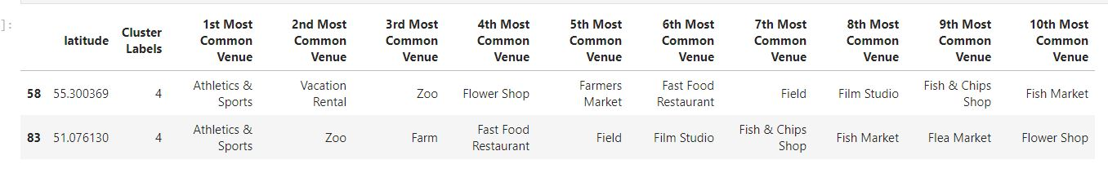
Result (contd)
Fifth Cluster
Analysis:There are family friendly places here. As we see Chesterfield, Doncaster and others have good greenery, supermarkets.

Slide 19
Discussion
First of all, even though the England Housing Market is always in demand in people who want to settle in United Kingdom.
We may discuss our results under two main perspectives.
First, we may examine them according to neighbourhoods. It is interesting to note that, although Notting Hill, Kensington, Chelsea, Marylebone and might be considered highly profitable venues to purchase a real estate according to amenities and essential facilities surrounding such venues i.e. elementary schools, high schools, hospitals & grocery stores, Basingstoke, Kent, Chesterfield, Doncaster are arising as next future elite venues with a wide range of amenities and facilities. Accordingly, one might target under-priced real estates in these areas of England in order to decide on settling down.

Slide 20
Discussion(contd)
Second, we may analyse our results according to the five clusters we have produced. Even though, all clusters could praise an optimal range of facilities and amenities, we have found two main patterns. The first pattern we are referring to, i.e. Clusters 0, 3 and 4, may target home buyers prone to live with children areas with supermarkets, parks, waterfronts. Instead, the second pattern we are referring to, i.e. Clusters 1 may target individuals who love pubs, theatres and soccer.
As my client is an Asian, I would suggest areas around Birmingham, Reading, Kent where more of Asian population are present with more Asian Restaurants and other cultural amenities.

Slide 21
Conclusion
UK housing prices is facing several different headwinds, including the prospect of higher taxes and a warning from the Bank of England that U.K. home values could fall as much as 30 percent in the event of a disorderly exit from the European Union. In this scenario, it is urgent to adopt machine learning tools in order to assist homebuyers in England to make wise and effective decisions. As a result, the business problem we were posing was : Helping one of my client to select a place to settle with family and children.
To solve this business problem, we clustered England neighbourhoods in order to recommend venues where homebuyers can make a real estate investment. We recommended profitable venues according to amenities and essential facilities surrounding such venues i.e. grocery stores, parks, restaurants.

Slide 22
Conclusion (contd)
First, we gathered data on England neighbourhood from the UK govt website. Moreover, to explore and target recommended locations across different venues according to the presence of amenities and essential facilities, we accessed data through Four Square API interface and arranged them as a data frame for visualization. By merging data on Neighbourhoods and data on amenities and essential facilities surrounding such properties from Four Square API interface, we were able to recommend profitable real estate investments.
Second, The Methodology section comprised four stages:
1. Collect Inspection Data
2. Explore and Understand Data
3. Data preparation and pre-processing
4. Modelling. In the modelling section, we used the k-means clustering technique as it is fast and efficient in terms of computational cost, is highly flexible to account for mutations in real estate market in England and is accurate.

Slide 23
Conclusion (contd)
We drew conclusion that England Housing Market is always in demand in people who want to settle in United Kingdom.
We may discuss our results under two main perspectives.
First, we may examine them according to neighbourhoods. It is interesting to note that, although Notting Hill, Kensington, Chelsea, Marylebone and might be considered highly profitable venues to purchase a real estate according to amenities and essential facilities surrounding such venues i.e. elementary schools, high schools, hospitals & grocery stores, Basingstoke, Kent, Chesterfield, Doncaster are arising as next future elite venues with a wide range of amenities and facilities. Accordingly, one might target under-priced real estates in these areas of England in order to decide on settling down.
Second, we may analyze our results according to the five clusters we have produced. Even though, all clusters could praise an optimal range of facilities and amenities, we have found two main patterns. The first pattern we are referring to, i.e. Clusters 1, 2 and 4, may target home buyers prone to live with children areas with supermarkets, parks, waterfronts. Instead, the second pattern we are referring to, i.e. Clusters 1 may target individuals who love pubs, theatres and soccer.

Slide 24
Conclusion (contd)
As my client is an Asian, I would suggest areas around Birmingham, Reading, Kent where more of Asian population are present with more Asian Restaurants and other cultural amenities.

